Slide 1
Unsupervised Data Augmentation Experimentations
Joanna Yu
Spring 2020
Notes:
Title of project: Unsupervised Data Augmentation Experimentations

Slide 2



Problem Statement and Motivation
Unlabeled Data
Labeled Data
Notes:
My project is motivated by the fact that most of the data we have today is unlabeled. <click>
But most deep learning algorithms need labeled data, which is scarce and expensive to produce.
Problem statement: how can we make good use of the unlabeled data to perform semi-supervised learning?

Slide 3
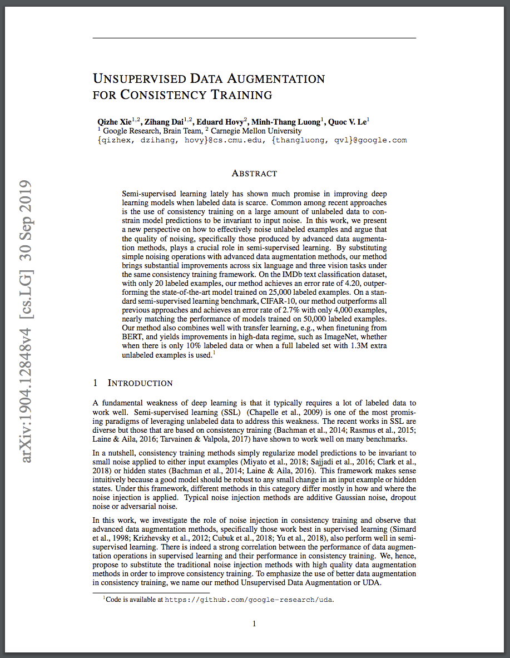
Unsupervised Data Augmentation
Consistency training boosts model robustness
Back translation shown to be a superior type of noise
Achieves state-of-the-art results using only 20 supervised training examples
Similar success on both text and image tasks
Notes:
Project is based on a paper done by Google, titled “Unsupervised Data Augmentation for Consistency Training” paper (UDA paper).
UDA paper shows that back translation is a superior type of noise for consistency training.
Using the IMDb dataset, the paper achieves SOTA results with only 20 supervised training examples, while purely supervised training uses 25K training examples.
The paper achieves similar success on both text and image.

Slide 4
Back Translation
Original:
I have no time.
Translate from English to French
Je n’ai pas le temps
New:
I do not have time.
Translate from French to English
Notes:
A quick background on back translation. In this model, a phrase is translated from English to French and then back to English. A hyper-parameter is used to tune the diversity of the translation.

Slide 5
Experiments
Track model performance with respect to the proportion of labeled vs unlabeled data.
Investigate how domain relevance of unlabeled data affects performance of the semi-supervised model.
Notes:
My project performs additional experiments to complement the work done in the UDA paper by extending the original framework. There are two main parts:
Track model performance with respect to the proportion of labeled vs unlabeled data.
Investigate how domain relevance of unlabeled data affects performance of this semi-supervised model.

Slide 6
Experiment Setup
Main Dataset: IMDb (25K labeled examples and 50K unlabeled examples)
BERT_{base} with sequence length of 128 for fine-tuning
Metric: Error Rate
Base Model: 20 labeled examples with full unlabeled dataset - 0.084
Measures performance for every 4K increase in unlabeled examples¹
Colaboratory Pro using GPU/TPU
Google Cloud Storage (BERT and 300+GB of model checkpoints)
¹ Model performance levels off after 16K unlabeled examples. Experiments were then performed on 24K, 48K, and full dataset beyond the initial 16K.
Notes:
For the experiment setup:
Main Dataset: IMDb
BERTbase with sequence length of 128
Metric: Error Rate
Base Model: 20 labeled examples with full unlabeled dataset - 0.084
Measures performance for every 4K increase in unlabeled examples. The unlabeled data is first augmented with back translation, and then pass to the model for fine tuning.
Colaboratory Pro and GCP storage

Slide 7
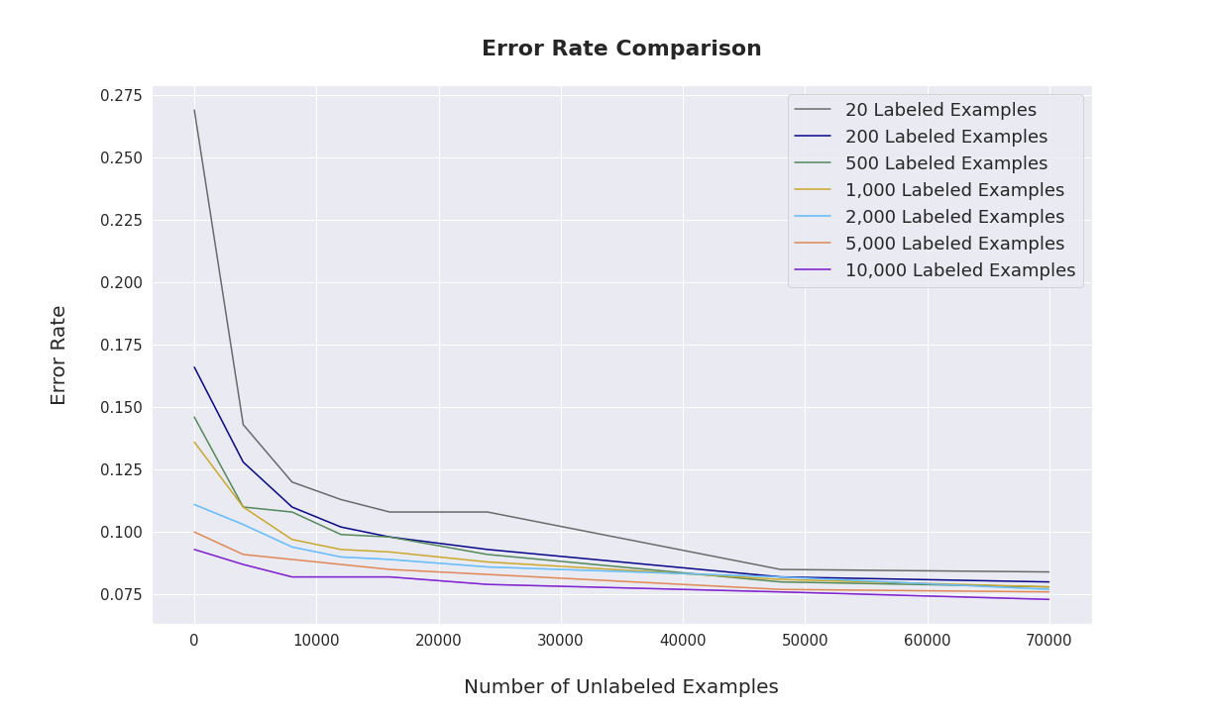
UDA Experiment Results
Notes:
Here is a graph of the results:
The y-axis is the error rate. The x-axis is the number of unlabeled examples. The different color lines represent different number of labeled examples. If we look at the gray line at the top- that’s the line using 20 labeled examples and we can see how the model performs as we increase the unlabeled data. (More fine tuning with unlabeled data does help improve performance.)
Using more labeled data can give the model a better starting point, but as we increase the unlabeled data, the error rates become more and more similar.

Slide 8
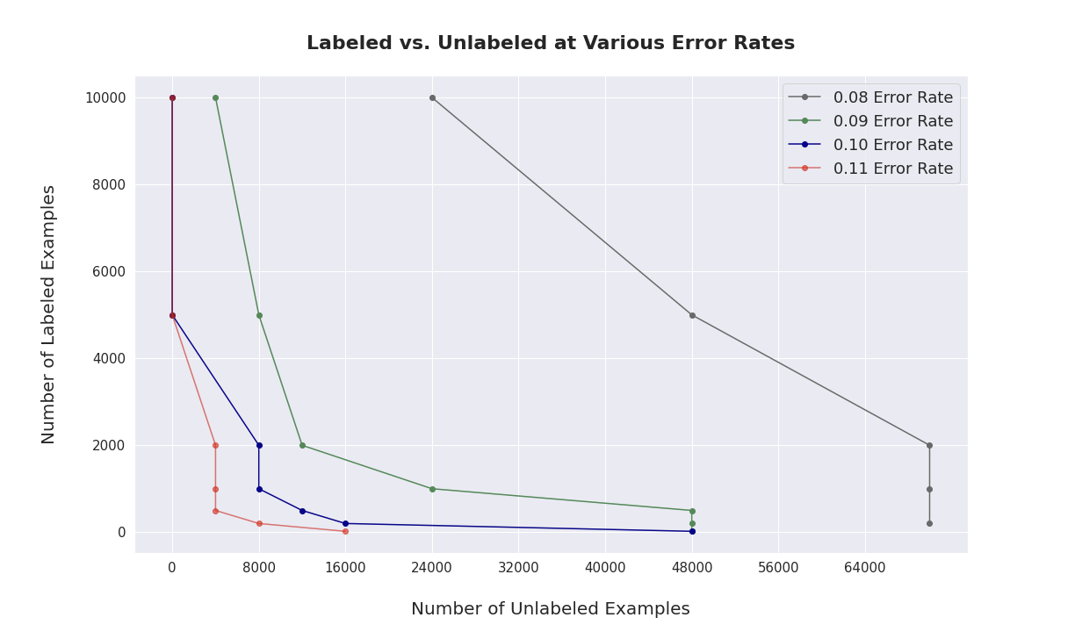
UDA Experiment Results - cont’d
10,000 Labeled
4,000 Unlabeled
500 Labeled
48,000 Unlabeled
Notes:
This graph shows the proportion of labeled and unlabeled data that can produce a given error rate.
The x-axis is the number of unlabeled examples. The y-axis is the number of labeled examples. The different color lines represent different error rates.
For the green line, which represents 9% error rate, we can either do <click> 10K labeled ] + 4K unlabeled], OR <click> increase the unlabeled to 48K and do 500 labeled. There is a general trend that unlabeled data can make up for the lack of labeled data.

Slide 9
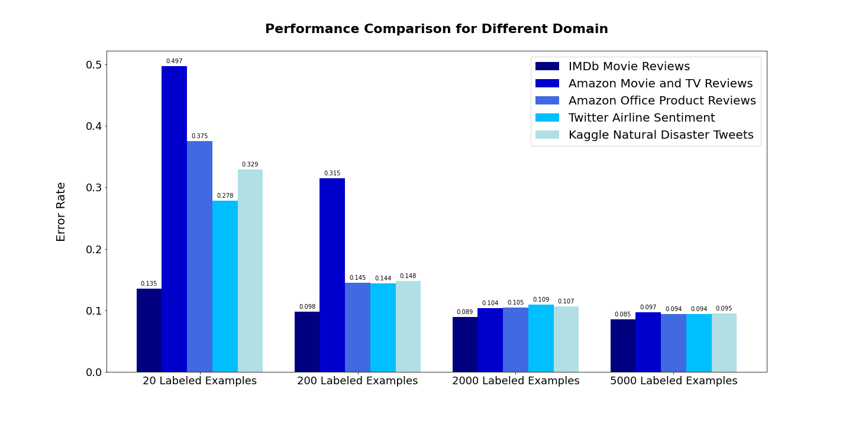
Domain Relevance Experiment Results
Notes:
For the domain relevance experiments, I used 4 additional datasets - Amazon movies and TV reviews, Amazon office products reviews, Twitter Airline, and Twitter Natural Disaster datasets.
The fading of the colors of the bar graph indicates how much the domain of each dataset deviates from the IMDb data. The darkest blue is IMDb itself. The slightly less dark blue is the Amazon movie dataset.
The x-axis shows the number of labeled examples for the supervised training. The y-axis is the error rate. (I use 16K unlabeled examples for fine tuning, or if the dataset has < 16K, I use the whole dataset.) <click>
Surprisingly the Amazon movie dataset doesn’t do very well initially even though it’s considered completely in-domain with IMDb.
The result is interesting in that as we increase the size of labeled data, domain relevance doesn’t seem to play a big role, which is not what I had expected.

Slide 10
Conclusion
Fine-tuning with augmented unlabeled data helps model performance
More experiments needed to identify more concrete patterns

